Slide 1
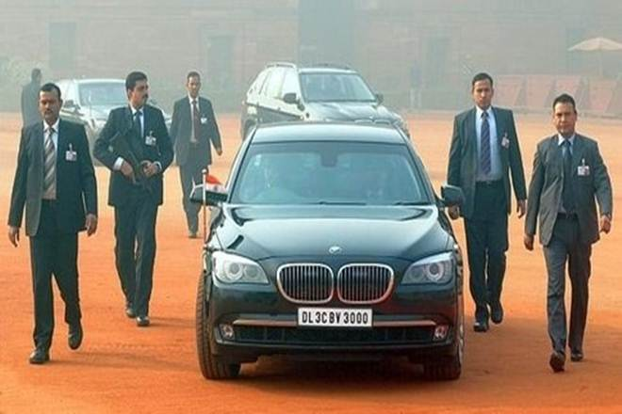
Securing Your Digital Self and Digital Inheritance
Scott Goodwin

Slide 2
Agenda
Passwords
Security Questions
Click here or not
Currency
Digital Inheritance

Slide 3
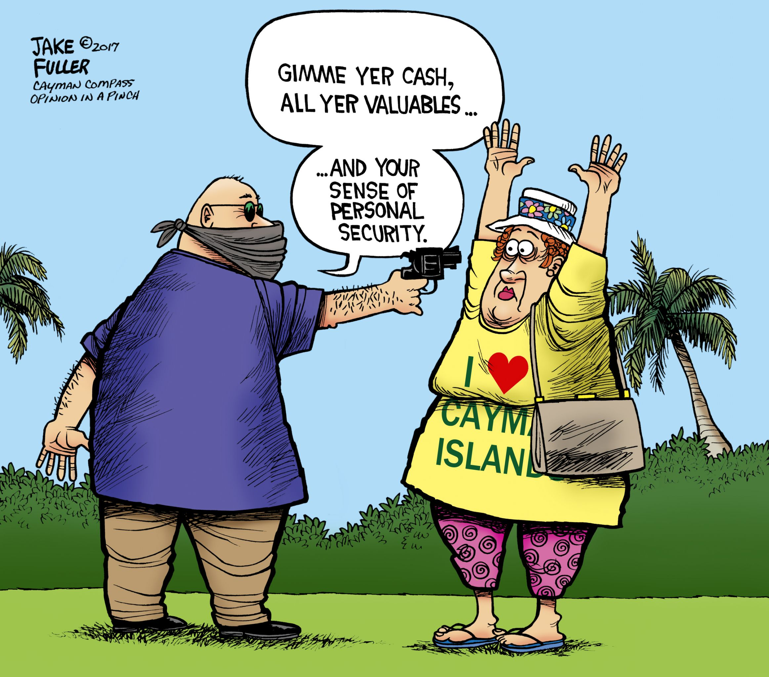
Personal Security

Slide 4

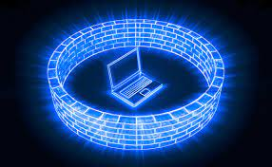
Defender’s Paradox
When an attacker is on the Outside, they only need to be right once.
Once the Attacker is Inside, they need to be right 100% of the time and now the Defender only needs to be right once to catch them.

Slide 5
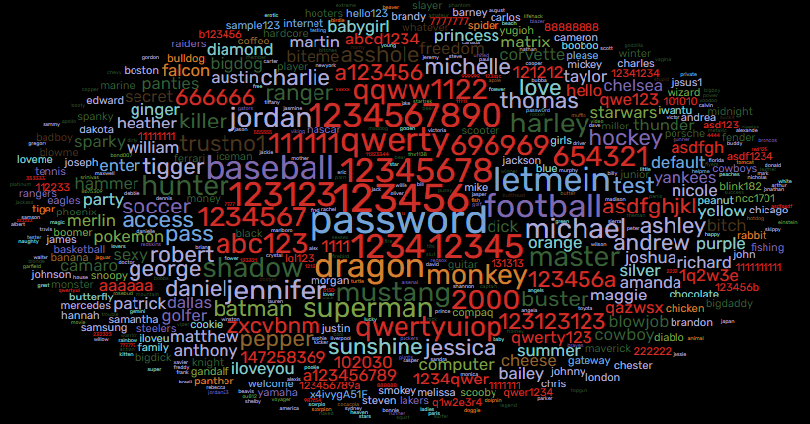
Most Common Passwords

Slide 6
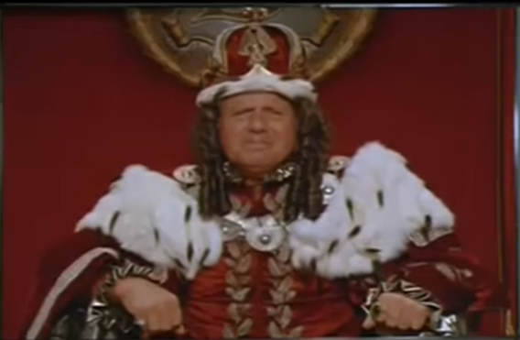
Passwords
What you know
What you are
What you have
Combined with user IDs
>100 passwords on average

Slide 7
Passwords
Longer is better
Each character increases the complexity exponentially. This is why passwords typically have a minimum requirement of 8 characters
26 lower case letters
26 upper case letters
10 digits
~30 special characters
92 options per character

Slide 8
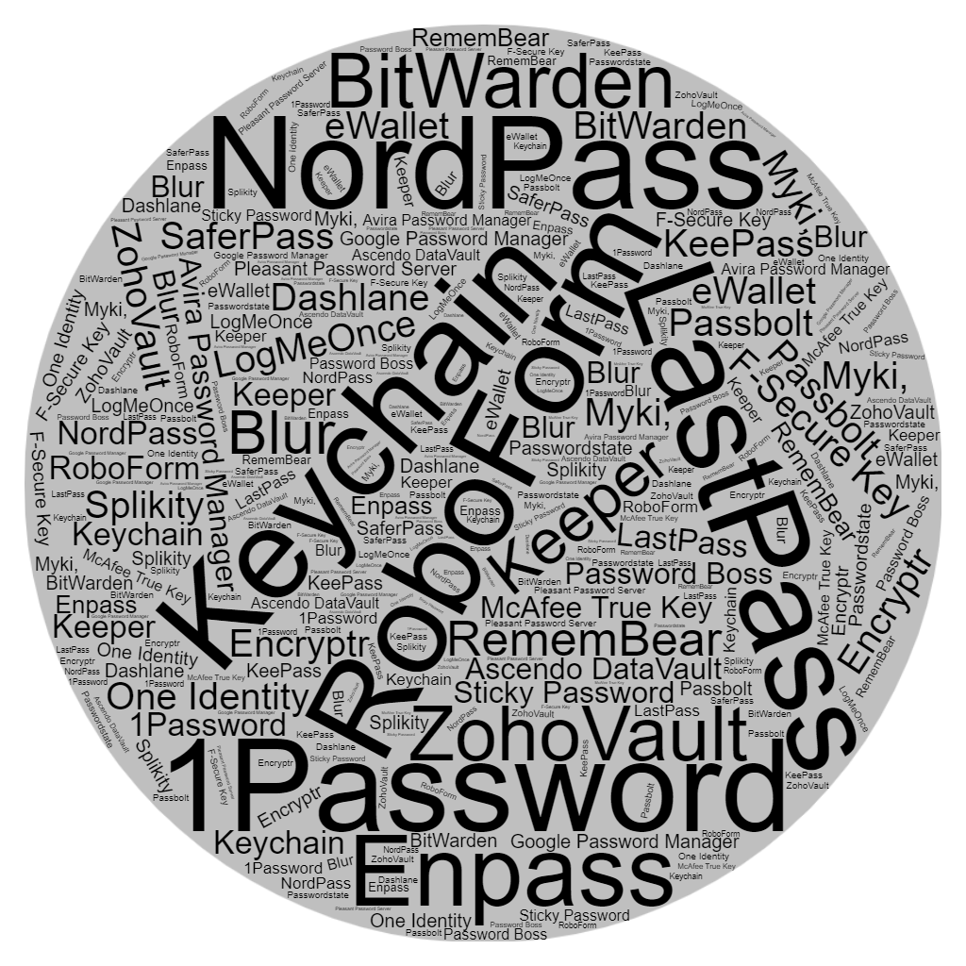
Password Managers
Do not store
passwords in
browsers
Use a password
manager

Slide 9




Multi-Factor Authentication
Additional code from token, application, text, email
Use whenever possible
Can allow for shorter passwords
Can use physical devices

Slide 10
Security Questions
Do not answer the questions with real answers, i.e. Mother’s maiden name
Do not use the same answers across accounts
Save your answers in your password manager
Use a couple of random words together for answers
Remember to associate answers with questions, i.e Mother’s maiden name = SabreDraftShare

Slide 11
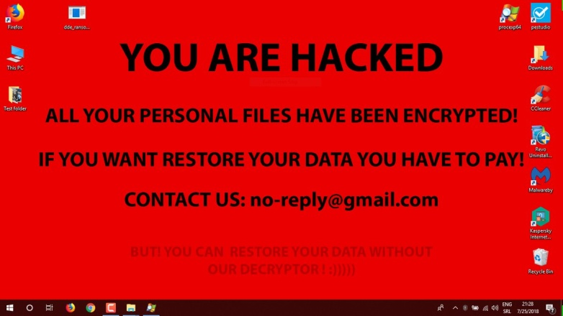
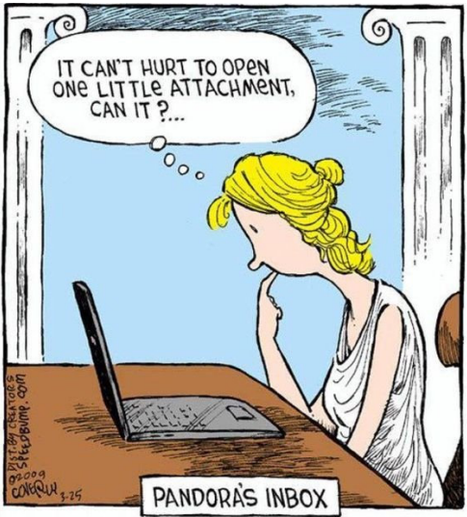
Click here or not
Ransomware
Ransomware is a type of malware that can be covertly installed on a computer without the user’s knowledge or intention.
It restricts access to the infected computer system in some way and demands that the user pay a “ransom” to the malware operators to remove the restriction.
Malware
Malware is software designed to infiltrate or damage a computer system without the owner's informed consent.
Malware should not be confused with defective software, that is, software which has a legitimate purpose but contains bugs.

Slide 12
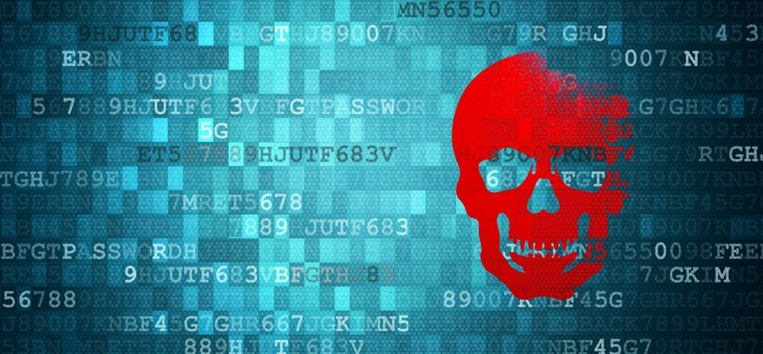

Click here or not
Know what you are clicking
Avoid clicking on links or opening attachments and emails from people you don't know or companies with whom you don't do business
Redirects
Bitly, Rebrandly,
TinyURL, BL.INK,
Shorby, Short.io,
Sniply

Slide 13

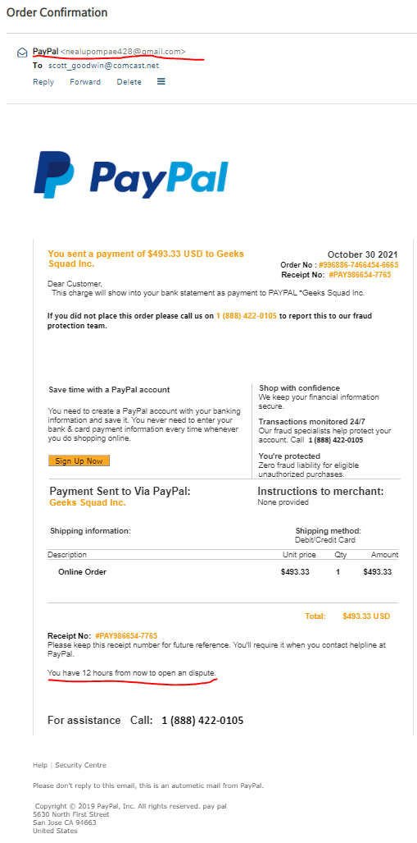
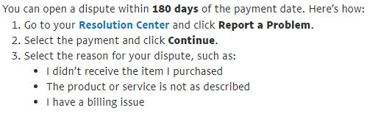
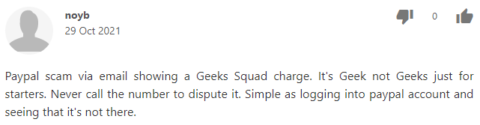
What Should I Do?

Slide 14
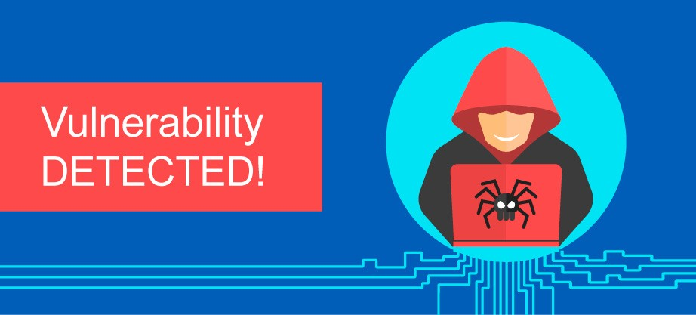

Personal Currency
Who doesn’t love new stuff
Make sure your software is up-to-date
Reboot your system on a regular basis
(i.e., weekly) to install patches
Software
OS
Virus scanners

Slide 15
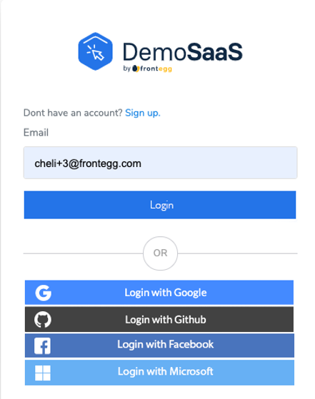
Logging in with Single Application
Benefit of single user ID and password to log in to other applications
Detriment of single user ID and password to log in to other applications

Slide 16

Digital Inheritance
Now that you have all these accounts and devices, how is someone to access?
Banks, Stocks, Crypto, Multifactor, Utilities, Cellphone, Andriod/Apple, Mortgage, Social Media, Rewards Programs, Insurance

Slide 17
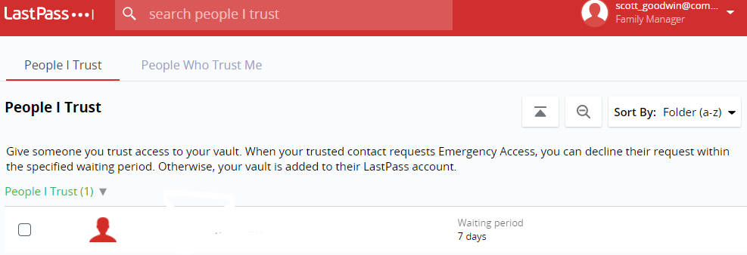
Password Managers
Password manager – Most have emergency access

Slide 18
What about all these sites?
Facebook: Decide if you want your account deactivated, deleted, or memorialized. If you choose to have your account memorialized, appoint a legacy contact to manage.
Google: Through the “Inactive Account Manager”, choose a “trusted contact” to receive wgatever data you choose to leave them. You may also choose to delete all your data. This includes Google products and subsidiaries: Google+, Blogger, Drive, Mail, YouTube
Instagram: Decide if you want your account to be memorialized. Have someone contact Instagram, or get your account information.
LinkedIn: Decide if you want your account deleted or memorialized.
Pinterest: Have someone deactivate your account
Online Dating: Have someone contact the site and close online dating accounts
Yahoo: Have someone contact Yahoo and request your account be deleted, this include Yahoo subsidiaries such as Flickr and Tumblr.
Twitter: Have someone notify Twitter and deactivate your account, including Vine account, if you have one.
Wordpress: Have someone contact Wordpress and decide what you want them to do – keep your blog or take it down. Other blogging sites may have other rules. Contact them to be sure.

Slide 19
Other services to consider
Streaming services
It’s a utility
Who do you share them with?
Multifactor Authentication
Who has your passcode?
Setup multiple authentication options
Domains
How to transfer ownership
Frequent Flyer and rewards programs
Unoffical way around the rules as well as an official appeal process
Stock and Crypto Accounts

Slide 20
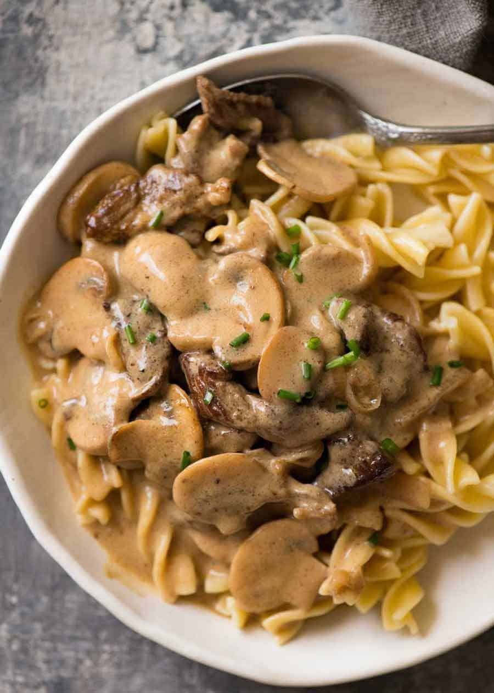
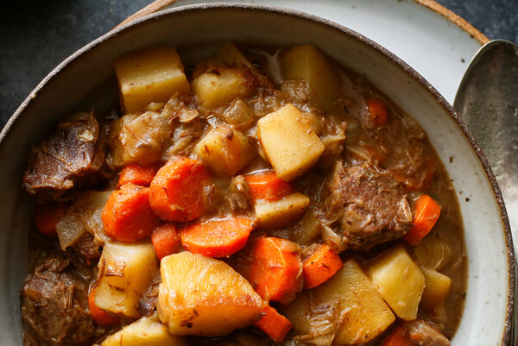
Some Favorite Phrases
If you cannot determine the product then you are the product.
It is not paranoia when they really are out to get you.
If it sounds too good to be true, it is.
You cannot use beef stew for your password because it is not stroganoff.

